Slide 1
Hands-on Intro to Node.js
Wi-fi: VHTGuest
Login: devguest
Password: VHTguest!
Jerry D’Antonio
Akron Code Club
@jerrydantonio

Slide 2
What is Node.js
“Node.js® is a platform built on Chrome's JavaScript runtime for easily building fast, scalable network applications. Node.js uses an event-driven, non-blocking I/O model that makes it lightweight and efficient, perfect for data-intensive real-time applications that run across distributed devices.”
http://nodejs.org/

Slide 3
WTH?

Slide 4
Reactor Pattern
“The reactor design pattern is an event handling pattern for handling service requests delivered concurrently to a service handler by one or more inputs. The service handler then demultiplexes the incoming requests and dispatches them synchronously to the associated request handlers.”
http://en.wikipedia.org/wiki/Reactor_pattern

Slide 5
Wait, what?

Slide 6
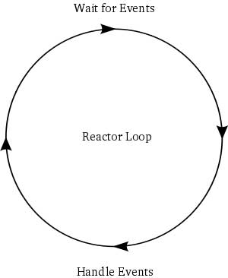
http://www.raywenderlich.com /3932/networking-tutorial-for-ios-how-to-create-a-socket-based-iphone-app-and-server/reactor-1

Slide 7
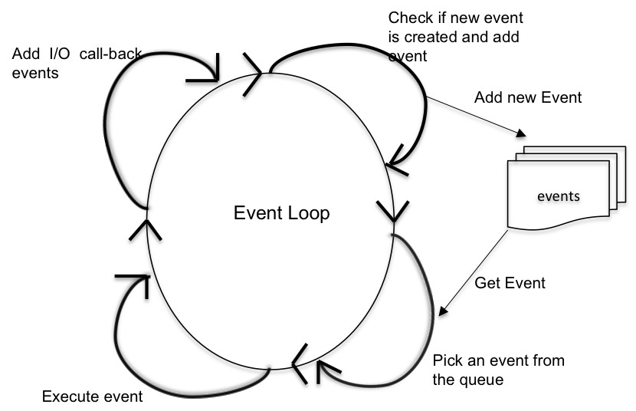
http://venkateshcm.com/2014/04/Reactor-Pattern-Part-2-Non-blocking-I-O/

Slide 8
Reactor Pattern
“The reactor design pattern is an event handling pattern for handling service requests delivered concurrently to a service handler by one or more inputs. The service handler then demultiplexes the incoming requests and dispatches them synchronously to the associated request handlers.”
http://en.wikipedia.org/wiki/Reactor_pattern

Slide 9
Reactor Pattern Pros/Cons
Pros
App code is decoupled from concurrency code
Event handlers can be reused
No locking or object synchronization
Cons
Difficult to debug due to control flow inversion
Terrible with processor-intensive operations
Callbacks…
Callbacks…
Callbacks…

Slide 10
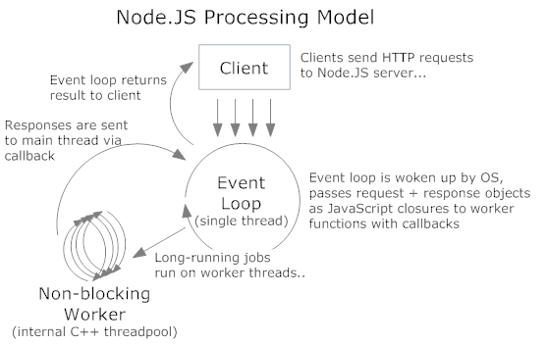
http://www.aaronstannard.com/post/2011/12/14/Intro-to-NodeJS-for-NET-Developers.aspx

Slide 11
What is Node.js
“Node.js® is a platform built on Chrome's JavaScript runtime for easily building fast, scalable network applications. Node.js uses an event-driven, non-blocking I/O model that makes it lightweight and efficient, perfect for data-intensive real-time applications that run across distributed devices.”
http://nodejs.org/

Slide 12
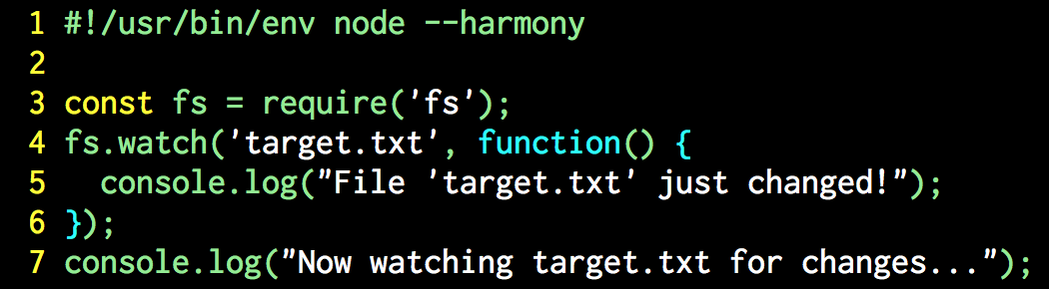
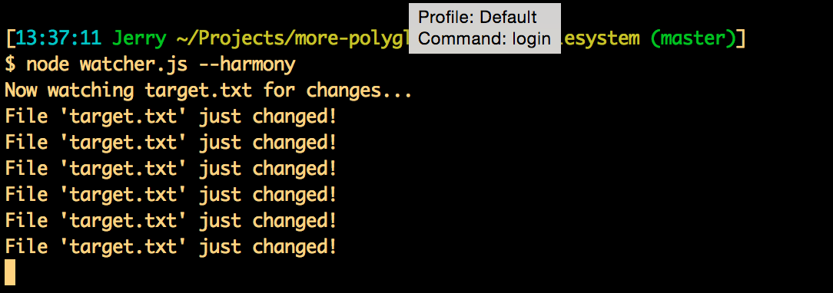
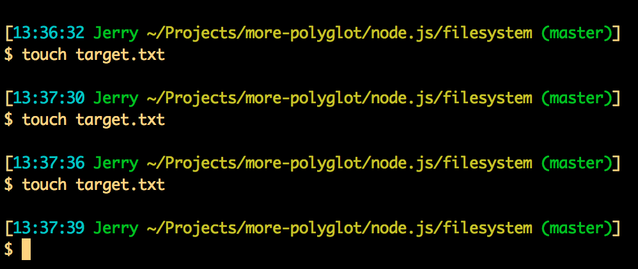
Simple Node.js App

Slide 13
Key Point
A Node.js application isn’t a complete program— it’s a reactor initializer!

Slide 14
Structure of a Node.js App
Import required libraries
Create global objects
Listen to events
Define the event
Attach one or more callbacks
Implicitly start the reactor
Run forever!

Slide 15
What To Do
Download and install Node.js
http://nodejs.org/download/
Verify Node.js is installed and working
`npm –h` to verify that NPM is working
`node` followed by [CTRL-C]
Install NodeSchoolmodule
http://nodeschool.io/#workshoppers
`npm install -g learnyounode`
`learnyounode`

Slide 16
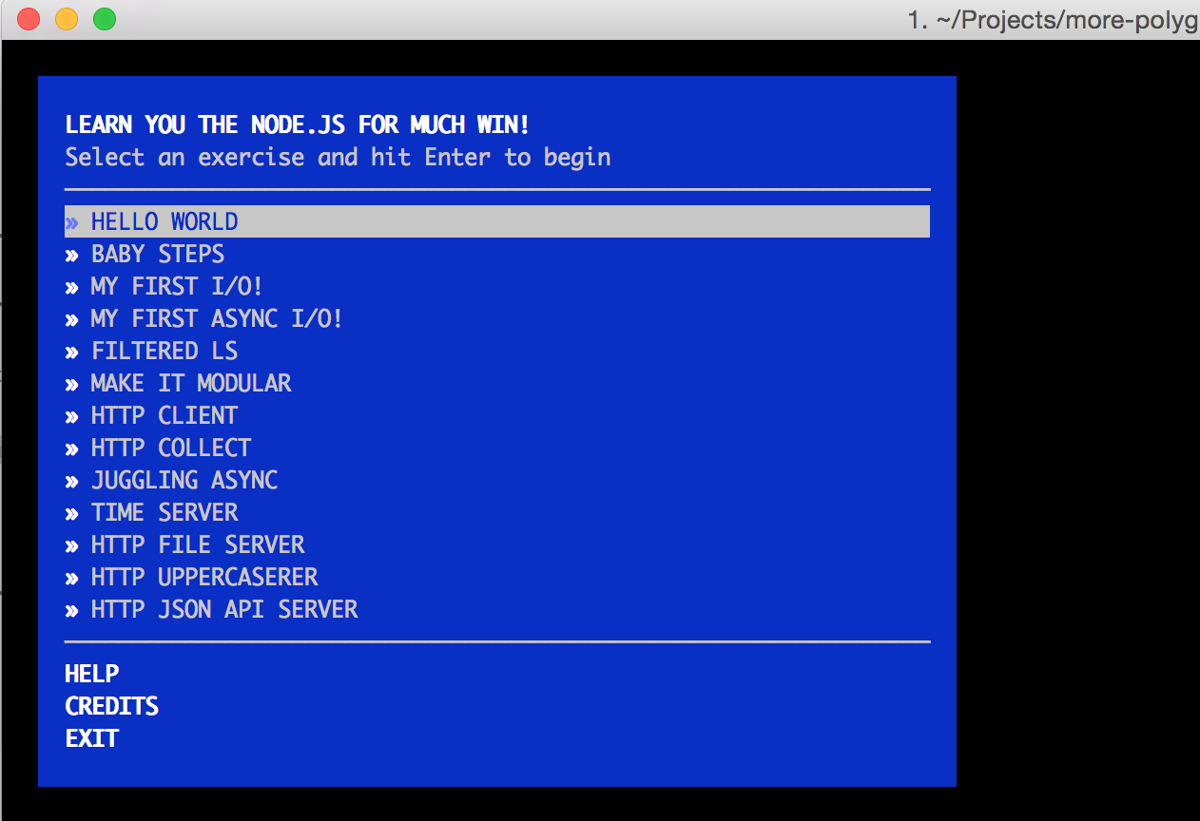
Learn You The Node.js

Slide 17
Retrospective
How far did you get into the tutorials?
Which was the simplest tutorial?
Which was the hardest tutorial?
What is your general impression of reactor-based programming?
What is your general impression of Node.js programming?
Do you plan to do more work with Node.js?

Slide 18
Resources
http://nodejs.org/
http://nodeschool.io/
https://www.codeschool.com/courses/real-time-web-with-node-js
https://pragprog.com/book/jwnode/node-js-the-right-way
https://github.com/jdantonio/more-polyglot

